Slide 1
Note: The data and information in this document is reflective of a hypothetical situation and client. This document is to be used for KPMG Virtual Internship purposes only.
KPMG Virtual Internship Program
Sprocket Central Pvt Ltd

Slide 2
Note: The data and information in this document is reflective of a hypothetical situation and client. This document is to be used for KPMG Virtual Internship purposes only.
Agenda
Introduction
Data Exploration
Model Development
Interpretation

Slide 3
Note: The data and information in this document is reflective of a hypothetical situation and client. This document is to be used for KPMG Virtual Internship purposes only.
Introduction
New customers analyze:
Look into these factors in new customers:
Bike purchase in last 3 years
Number of bike purchases in 3 years by job industry category
Job industry category.
Cars own on each states.(Tenure wise)

Slide 4
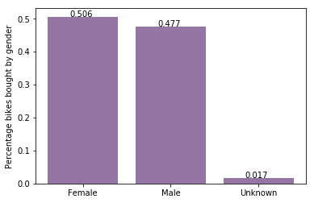
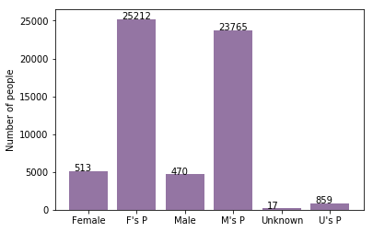
Note: The data and information in this document is reflective of a hypothetical situation and client. This document is to be used for KPMG Virtual Internship purposes only.
Model Development
Bike purchases last 3 years
As we can see, our new customers mostly Female with 50.6% purchases with total of 25,212 bikes
Male contributed to 47.7% purchases with 23,765 bikes
So we should focus on advertises on Female customers than Male customers
Scale number of customers by 10

Slide 5
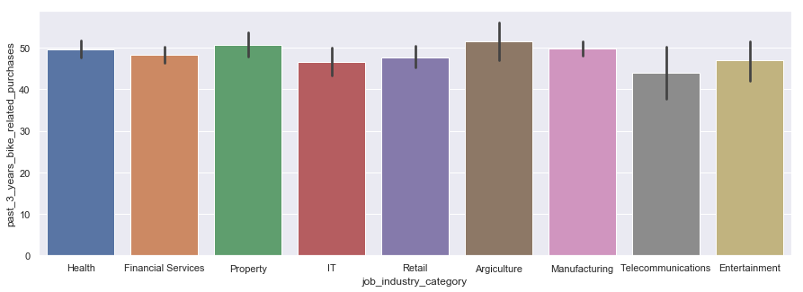
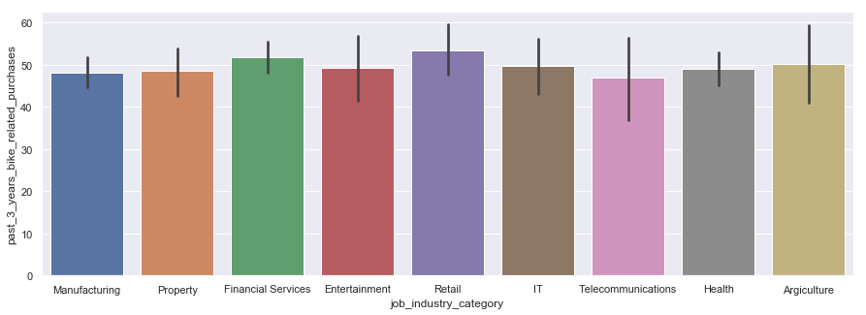
Note: The data and information in this document is reflective of a hypothetical situation and client. This document is to be used for KPMG Virtual Internship purposes only.
Model Development
Number of bike purchases in 3 years by job industry category

Slide 6
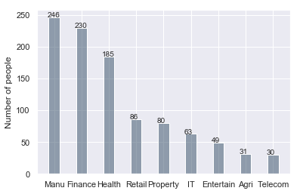
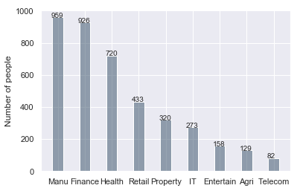
Note: The data and information in this document is reflective of a hypothetical situation and client. This document is to be used for KPMG Virtual Internship purposes only.
Interpretation
Job industry category.
New
Mostly our new customers are on Finance industry and our Manufactoring customers are still on top 2.
The rest industries is still same
Old

Slide 7
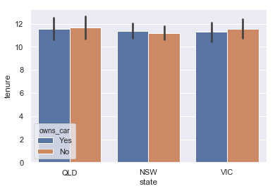
Note: The data and information in this document is reflective of a hypothetical situation and client. This document is to be used for KPMG Virtual Internship purposes only.
Interpretation
Cars owned
NSW should be considered the most since numbers of customers don’t own cars is significantly larger than that own.
VIC and QLD has more customers that own car that who don’t but we can try to have something so that those owns car will buy bikes.

Slide 8
Note: The data and information in this document is reflective of a hypothetical situation and client. This document is to be used for KPMG Virtual Internship purposes only.
Appendix

Slide 9
Note: The data and information in this document is reflective of a hypothetical situation and client. This document is to be used for KPMG Virtual Internship purposes only.
Appendix
This is an optional slide where you may place any supporting items.

